Slide 1

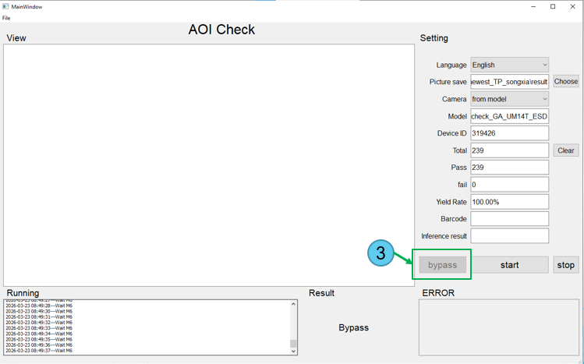
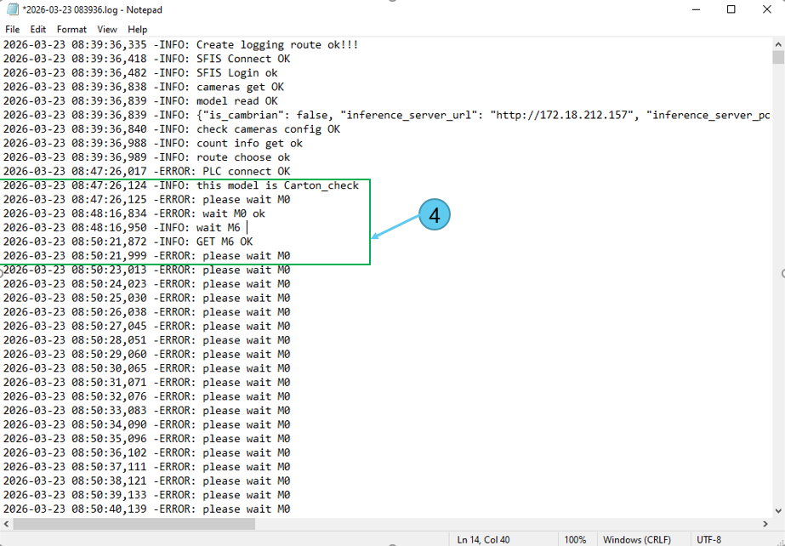
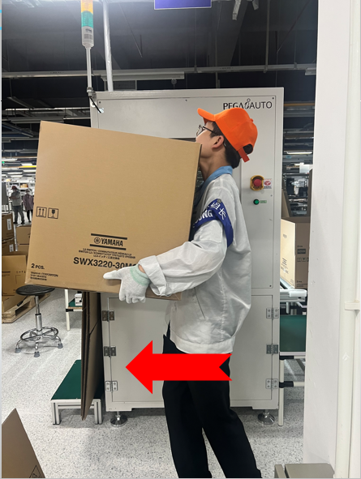
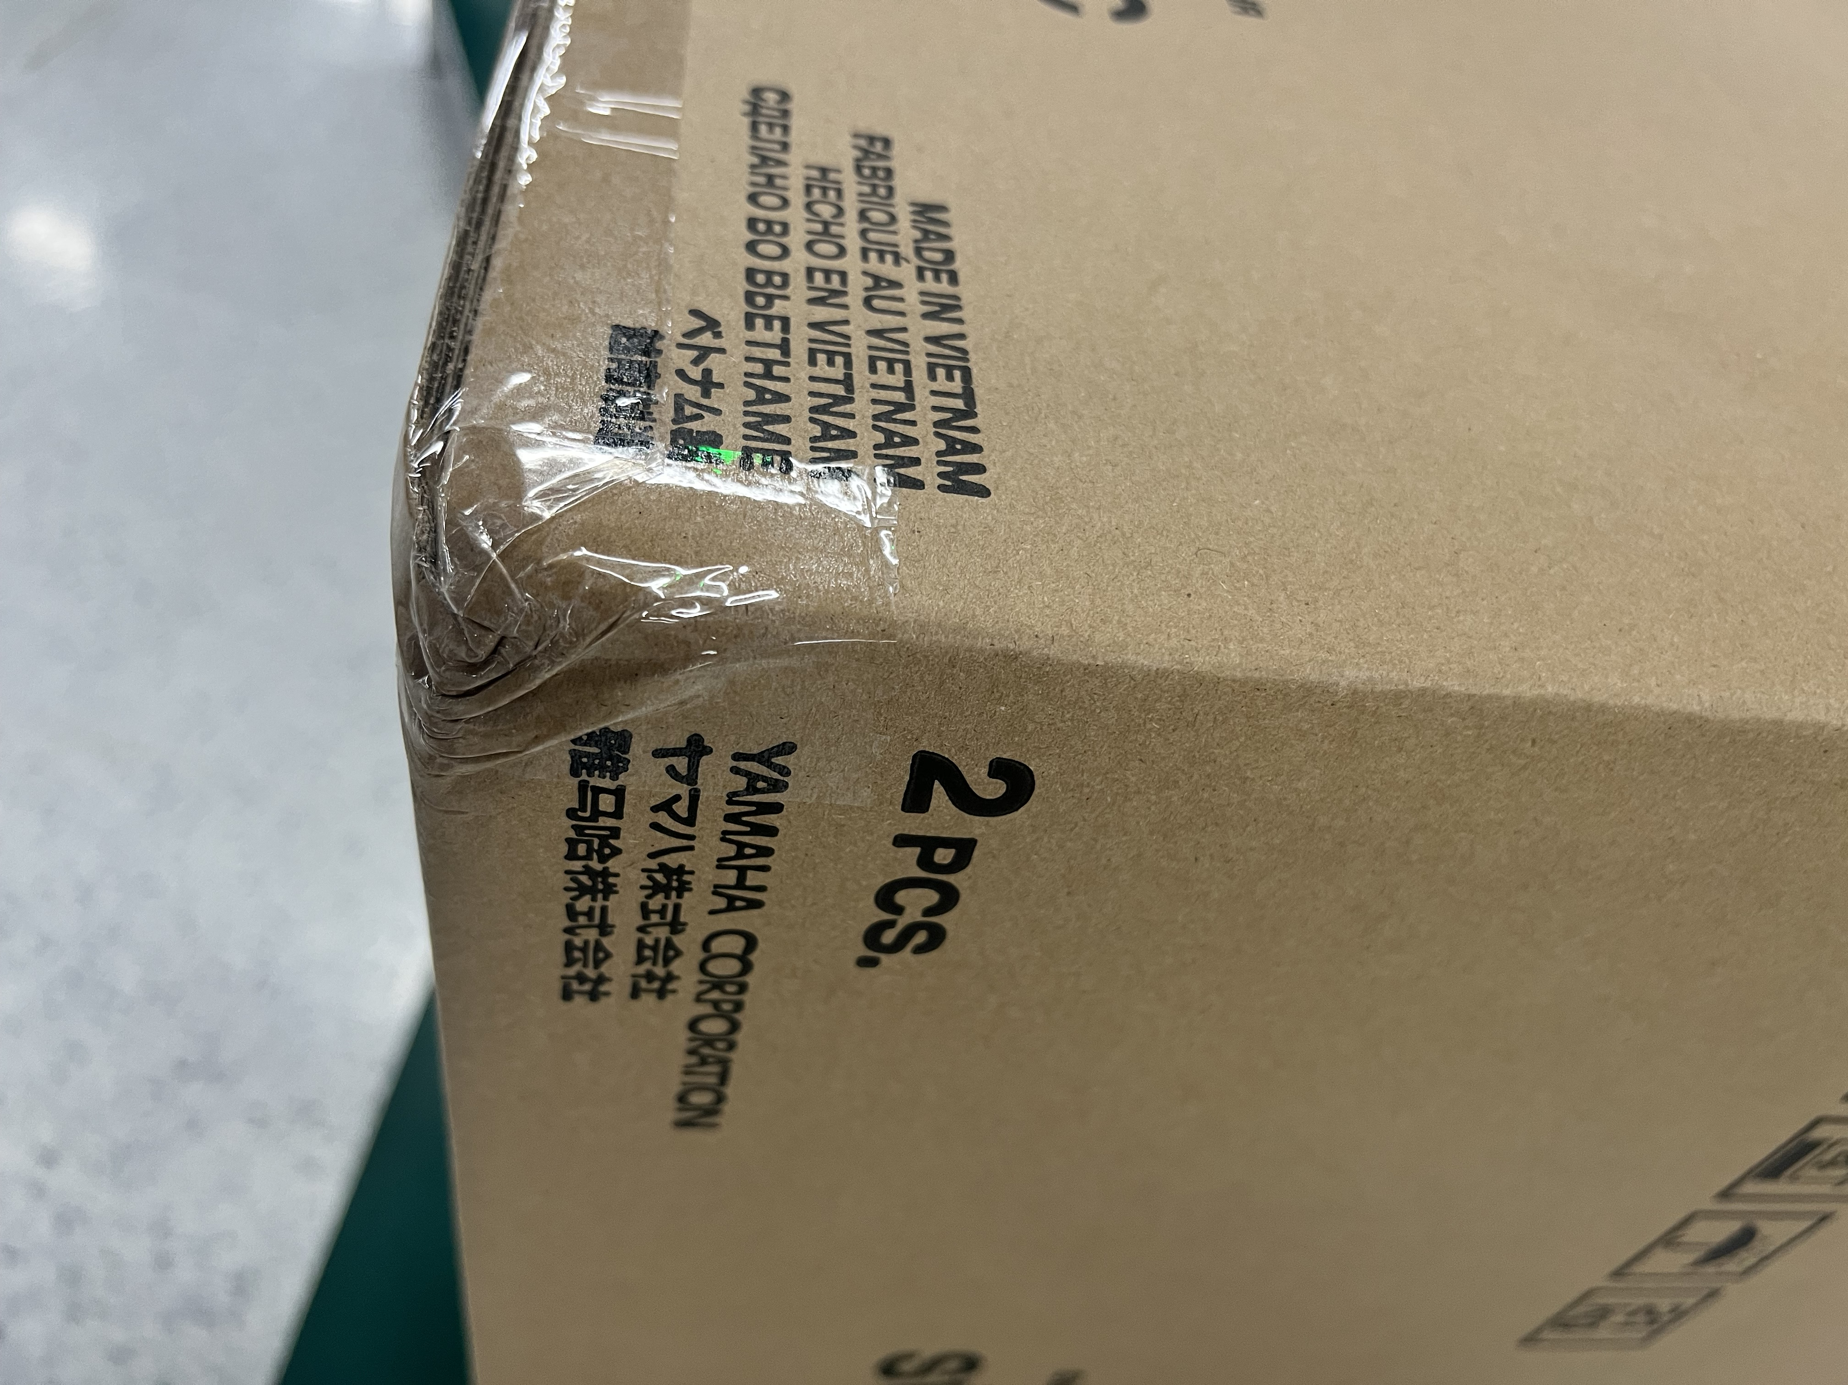
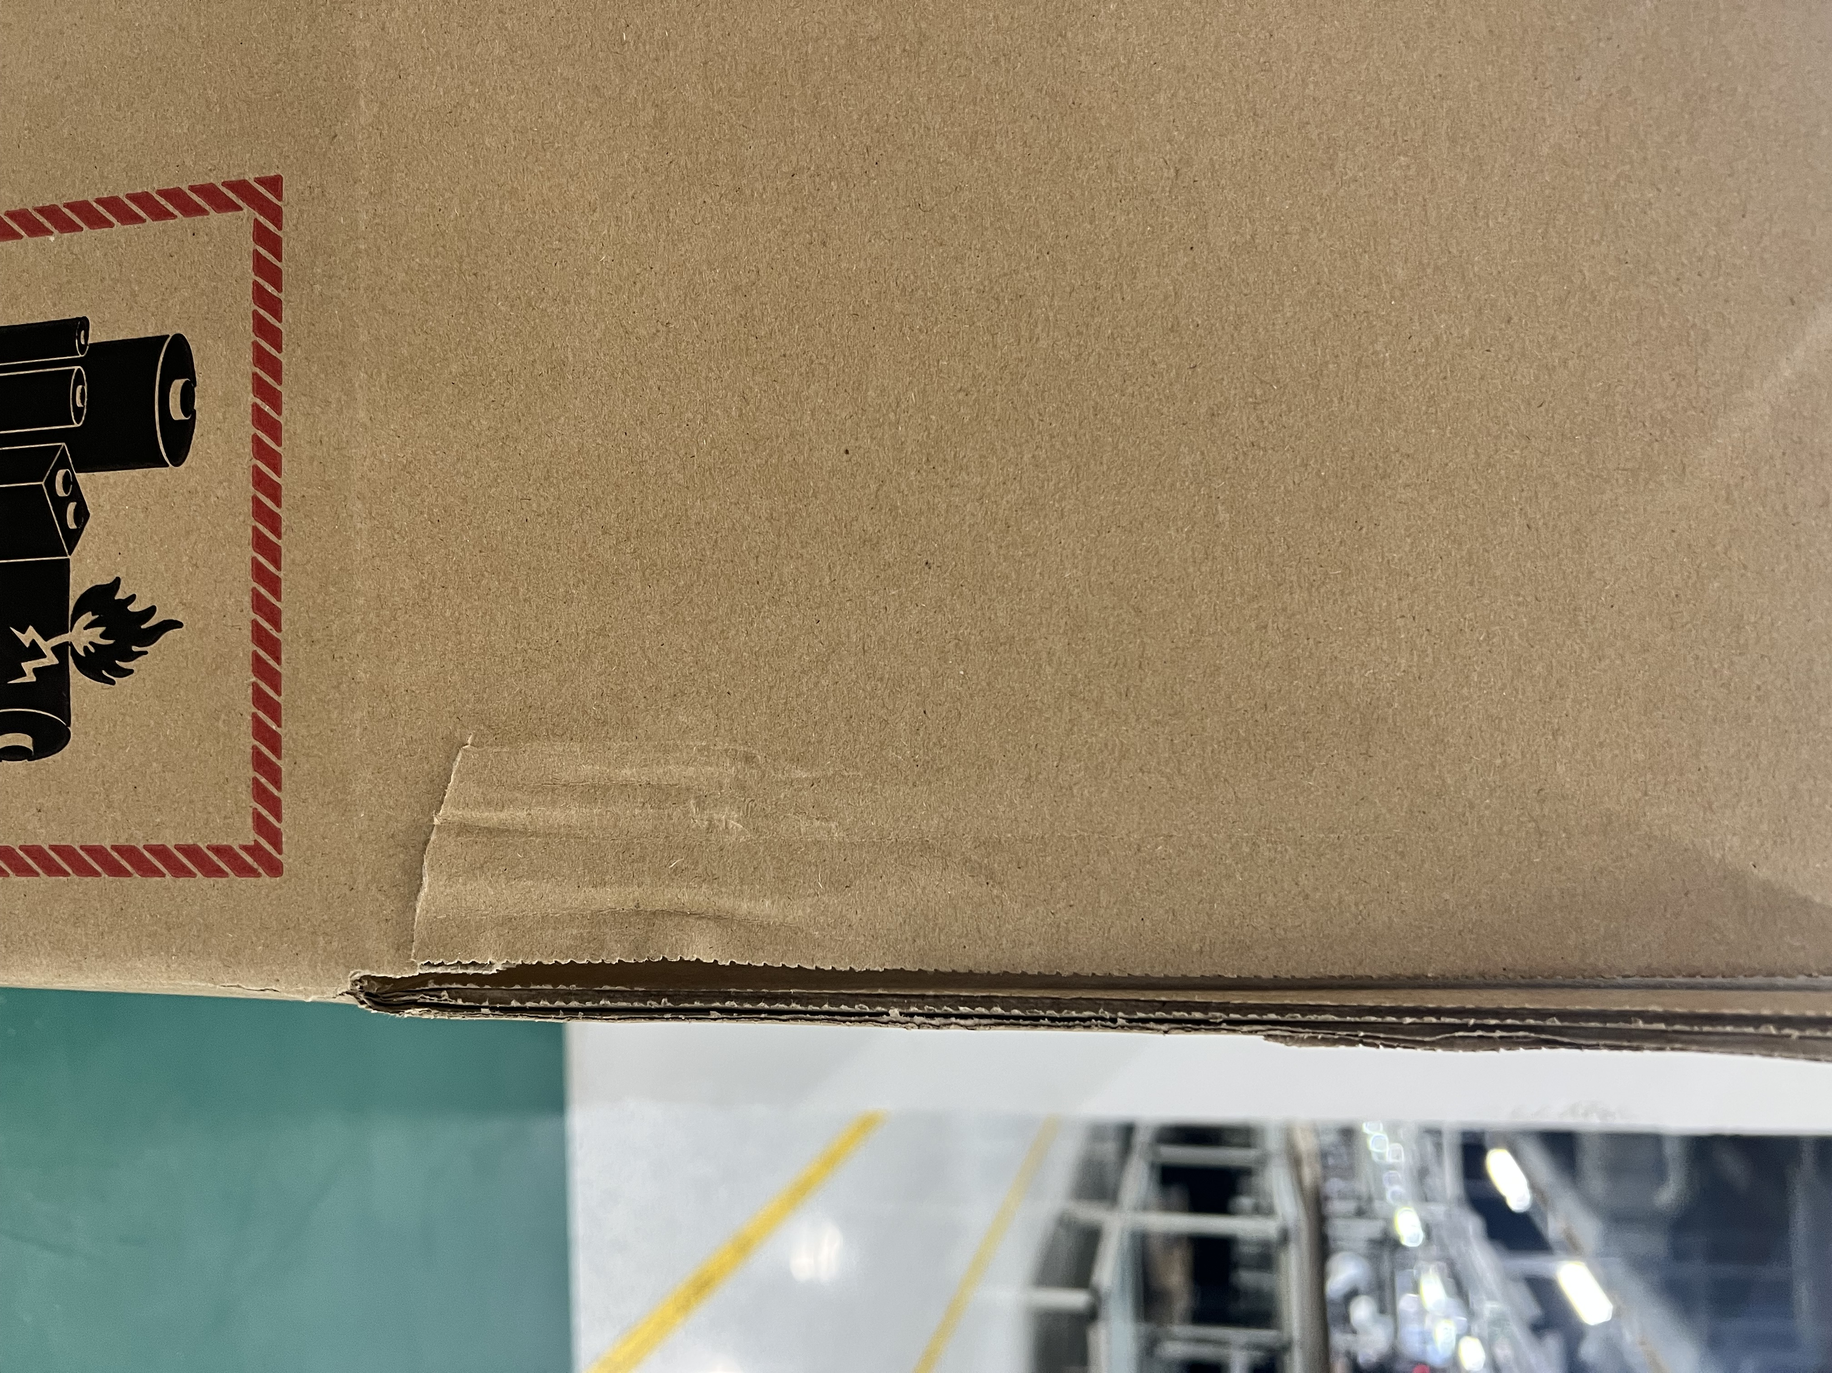
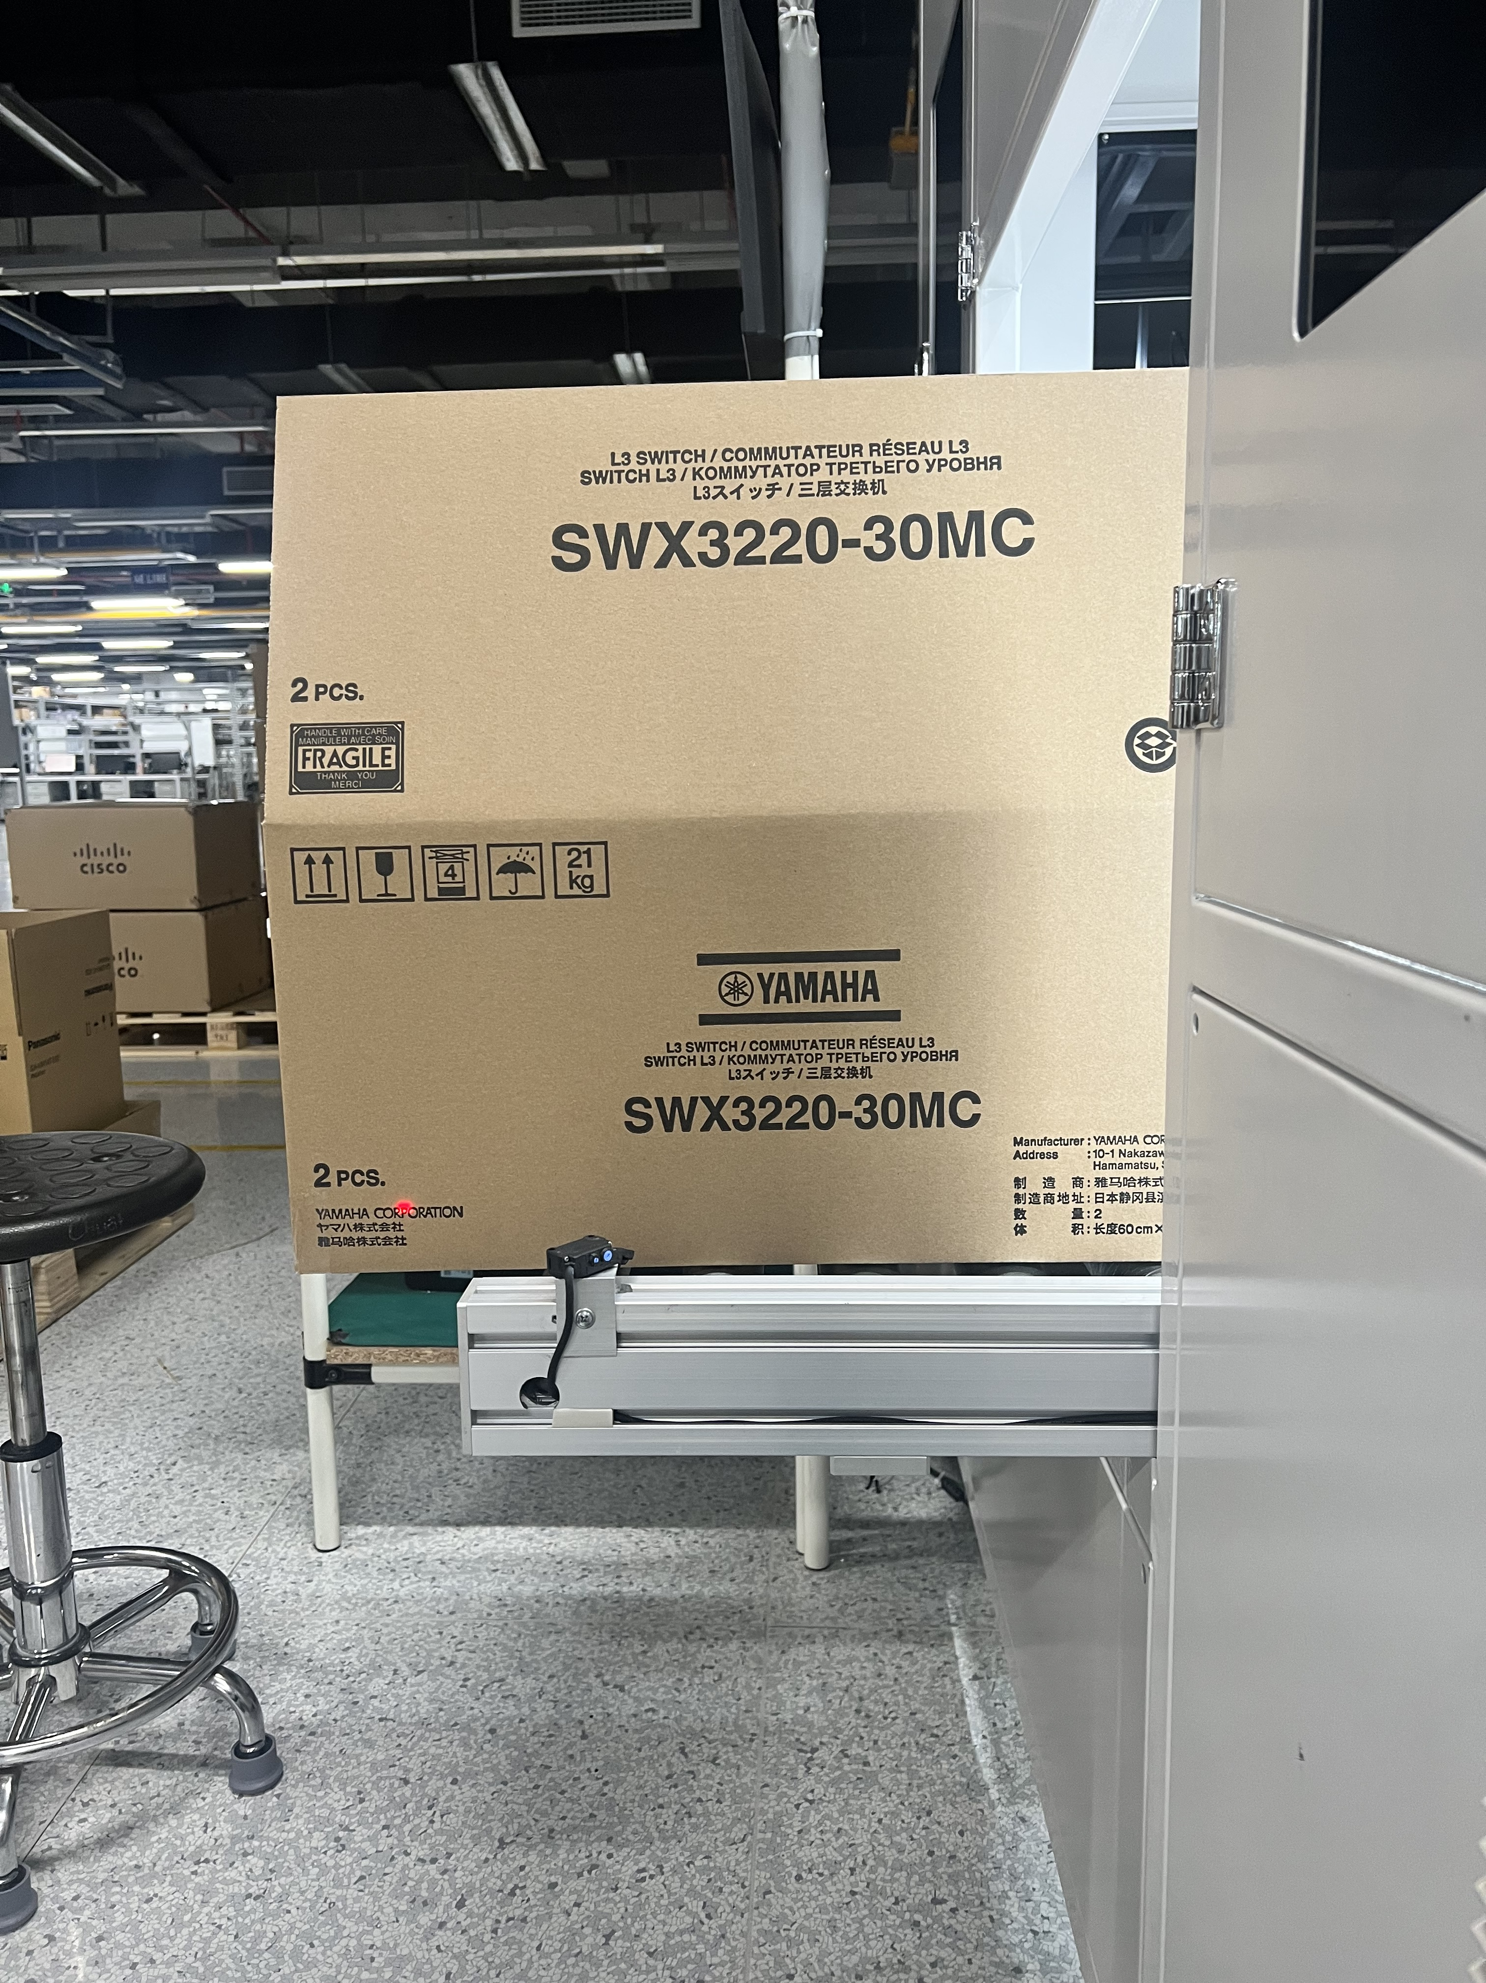
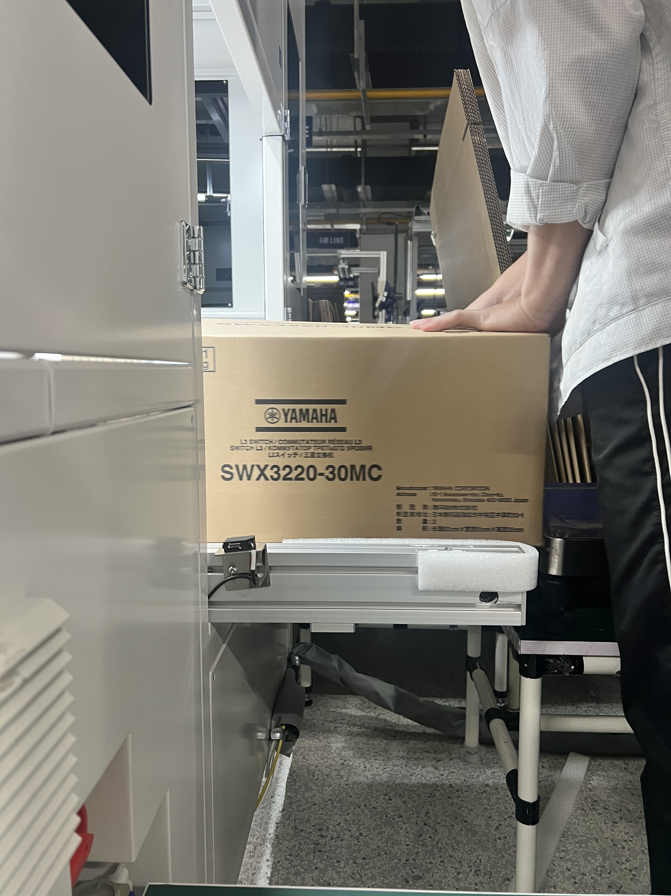
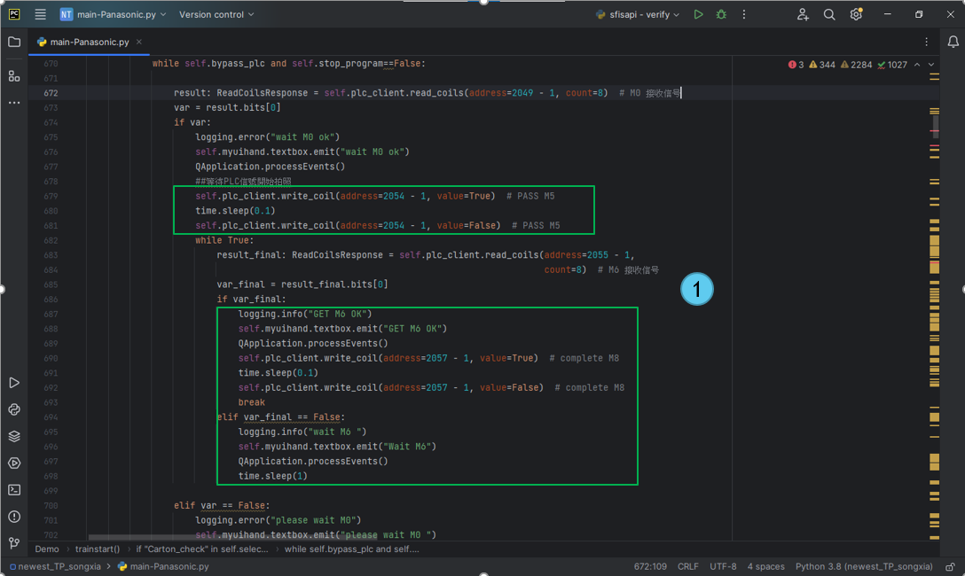
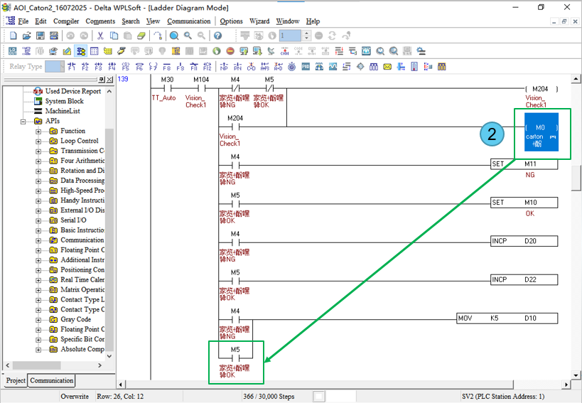
BG6
PVN
4K – Zumba - Station AOI Carton – Improvement
Before Improve
Due to their large size, the K10 and WET stations of the Zumba model must be operated manually. After operation, the cartons must be manually moved onto pallets.
This results in increased time, labor, and a potential risk of collisions during transportation.
Bypass mode is set.
I/O signal has been connected, Bypass mode testing is completed.
After Improve
After manually operating the K10 and WET stations, the operator (OP) uses the bypass mode of the AOI Carton to transport the cartons.
Thensuresis reduces operating time and no collisions occur during transport.
Details Improve
Added bypass function, transmit the M0 and M5 signal to the PLC.
The PLC receives M0 and M5 signals from the program. The conveyor will automatically move,
FME
BG6 PVN
Notes:
1. 看不懂改成bypass的用意是什麼? -> The purpose of the bypass is that since the K10 and WET stations were previously operate manually, the AOI machine only task is to transport the carton.
2. Zumba不用檢查嗎? -> Because the label of Zumba is positioned horizontally instead of vertically like the Yamaha/Panasonic models, the automatic AOI machine cannot be used. I thought that issue had been discussed before IE implemented the layout redesign.
3. 改善前後的成效是什麼? 增加UPH or? 請數據化 -> The effectiveness of improvements helps to enhance product quality and prevent the risk of errors during the work process. It's difficult to provide data.

